Slide 1
IngreGenius: An AI-Powered Culinary Compass
A Vision-to-Recipe System for Smarter Meal Planning
Computer Vision Final Project
Presented By -
Aayush Manoj Tirmalle (aayushmtirmalle@gmail.com)
Shreeharsh Ashok Gudibandi (shreeharshg65@gmail.com)

Slide 2
Problem Statement
Even when our refrigerators are full, we often face the same frustrating questions every day:
Decision Fatigue: "What can I possibly make with a random assortment of ingredients?" This leads to frustration and defaulting to unhealthy takeout.
Food Waste: We buy fresh groceries with good intentions, but a lack of inspiration means ingredients are often forgotten and spoil. A lot of the food supply is wasted.
The "Recipe Rut": We fall back on the same 2-3 familiar meals, missing out on creative and healthier ways to use the food we already have.

Slide 3
Objective
Our goal is to solve this problem by creating “IngreGenius”, a smart kitchen assistant with a clear, focused objective:
“To seamlessly transform a visual snapshot of available ingredients into actionable, categorized, and inspiring recipe suggestions.”
To achieve this, we set four key technical objectives:
Develop a Robust Vision System: Train a state-of-the-art YOLOv8 model to accurately identify a wide range of food items from a single image.
Integrate a Creative AI Chef: Leverage a powerful Large Language Model (LLM) to dynamically generate high-quality, easy-to-follow recipes.
Provide Intelligent Suggestions: Go beyond simple generation by offering users two distinct options: a Healthy recipe and a Tasty recipe, catering to different needs.
Create a Frictionless User Experience: Build an intuitive, multi-page Streamlit application that guides the user from photo to meal plan in just a few clicks.

Slide 4
Data Preprocessing - Building the "Super-Dataset"
The Problem: Conflicting Datasets
We started with multiple source datasets to get a wide variety of ingredients.
They had major inconsistencies:
Conflicting Classes: "Tomato" in one, "tomato" in another.
Conflicting Indices: The same object (e.g., "Apple") was class 2 in one dataset and class 15 in another.
The Solution: A 3-Step Unification Pipeline
We built a custom data pipeline to solve this:
Create a Master Class List:
Defined a single, standardized list of all unique classes (e.g., everything became lowercase).
Automated Label Remapping:
Wrote a Python script (remap_labels.py) that automatically read all original labels and rewrote them using the new, consistent master indices.
Virtual Dataset Merging:
Created a single master_data.yaml file that tells YOLOv8 to pull images from all source folders, creating a "virtual" super-dataset without duplicating image files.

Slide 5
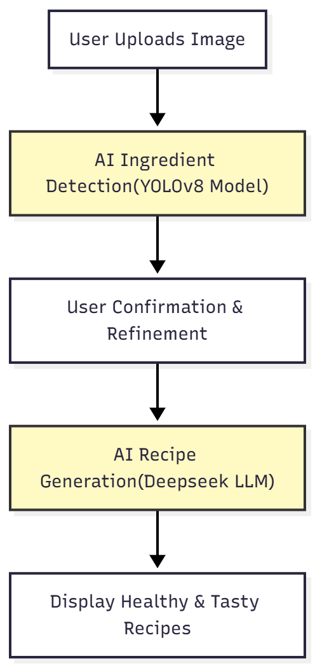
System Architecture & Data Flow
Tech stack:
Frontend: Streamlit (for rapid, interactive UI development)
Vision Model: YOLOv8s (for its optimal balance of speed and accuracy)
Language Model: Deepseek LLM (for high-quality, creative recipe generation)
Prompt Engineering: We used a “single API call” to generate both recipes, overcoming rate limits and improving efficiency.

Slide 6
Technical Deep Dive: The AI Core
1. Computer Vision Layer: The "Eyes"
Component: food_detector.py
Function: Loads our custom-trained YOLOvَ8s model to perform inference on the user's image and returns the final list of detected ingredients.
Why YOLOv8s?
Architecture: It's a single-stage, real-time detector, providing the strong accuracy-latency trade-off essential for an interactive user experience.
Variant Choice: We selected the "s" (small) variant as the optimal balance point: it delivers significantly higher accuracy (mAP) than the "nano" model, with much lower latency than the larger "medium" or "large" models.
2. Language Model Layer: The "Brain"
Component: recipe_generator.py
Function: Builds a single, highly-specific prompt from the final ingredient list and the user's chosen meal type.
How it Works:
API: Calls the Deepseek LLM via the efficient OpenRouter gateway.
Prompt Engineering: To overcome API rate limits, we designed a single prompt that instructs the model to generate both a healthy and a tasty recipe in one response.
Efficient Parsing: The prompt requires the model to insert a unique ---SEPARATOR--- token between the two recipes, allowing for robust and deterministic splitting of the response text with minimal overhead.
3. Frontend Orchestration: The "User Experience"
Framework: Streamlit
Function: Manages the user's journey through a multi-page application logic.
State Management: We utilized Streamlit's session_state to persist key data across pages, including:
The selected meal type.
The initial list of detected ingredients.
The user's final, edited ingredient list.
Deterministic Flow: The application ensures a clear and predictable user path: Upload → Confirm → Generate → Display

Slide 7
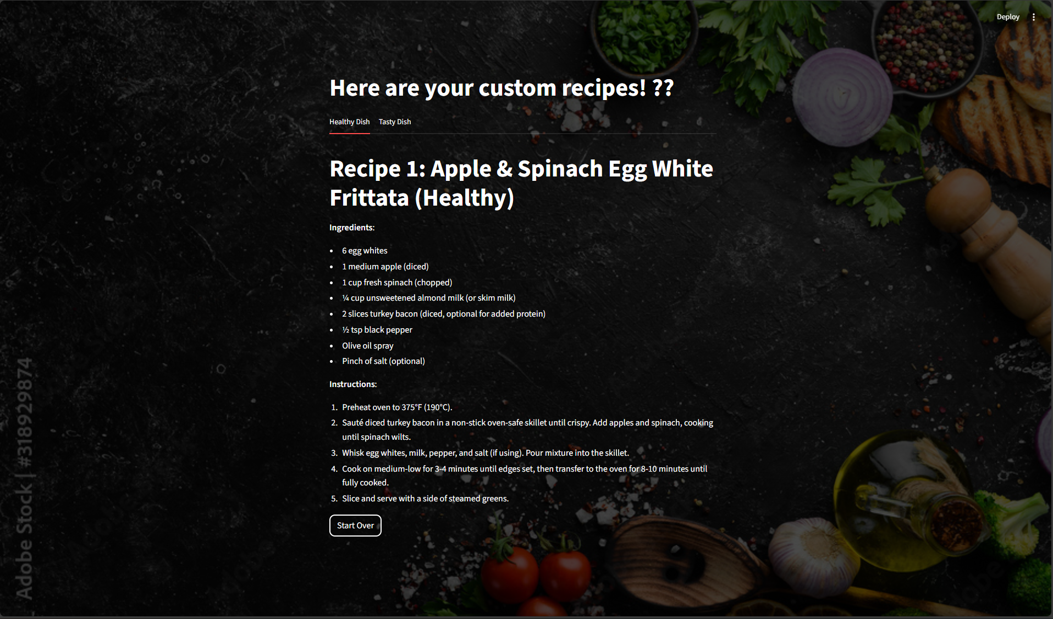
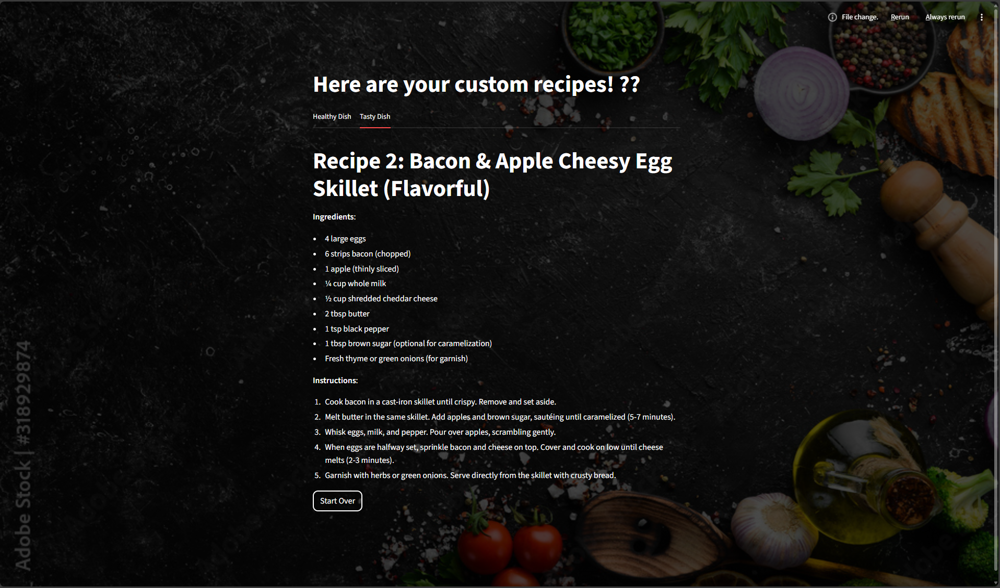
Results
Model Performance
Our trained YOLOv8s model is both fast and accurate:
mAP@0.5 (Classification Accuracy): 89.2%
Excellent at knowing WHAT the ingredients are.
mAP@0.5:0.95 (Localization Accuracy): 71.5%
Good at knowing precisely WHERE they are.
Latency: ~185ms per image on a T4 GPU.

Slide 8
Thank You
Questions?

